Slide 1
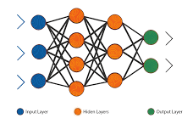
Optimizers, Overfitting & Regularization Techniques
Optimizers in Deep Learning
Overfitting & Underfitting
Regularization Techniques
Performance Comparison

Slide 2
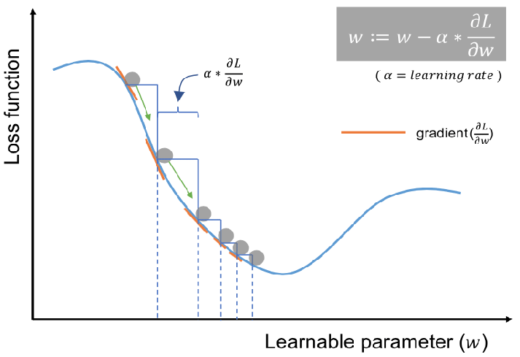
Gradient Descent

Slide 3
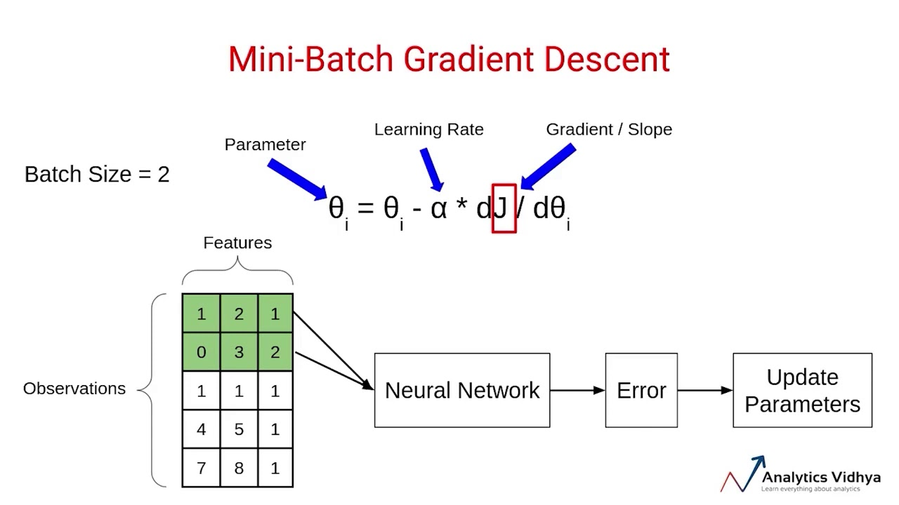
Gradient Descent

Slide 4
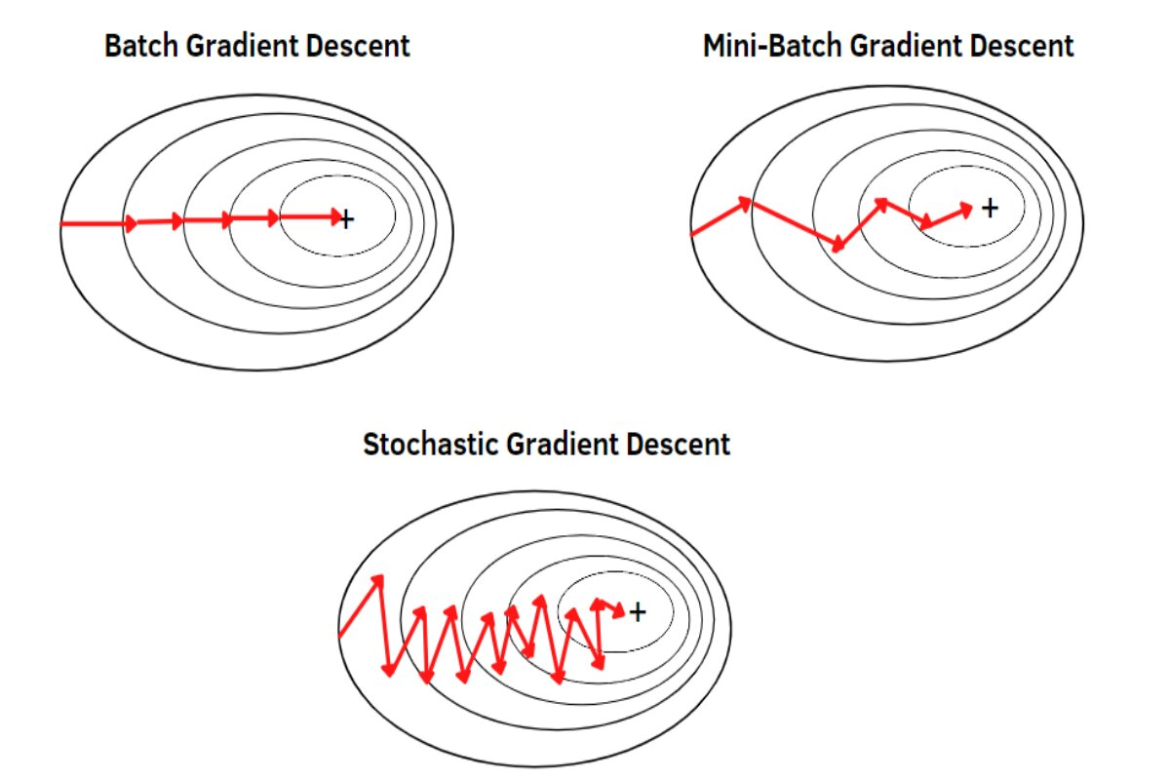
Gradient Descent

Slide 5

Optimizer Strategies Overview

Slide 6
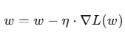
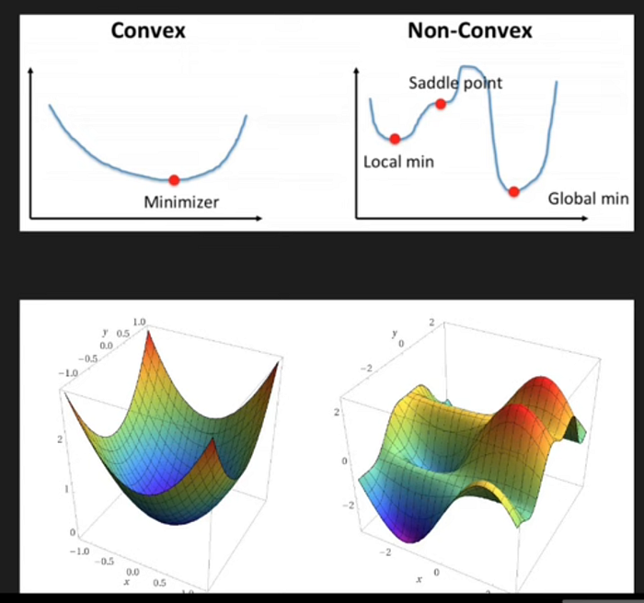
SGD

Slide 7
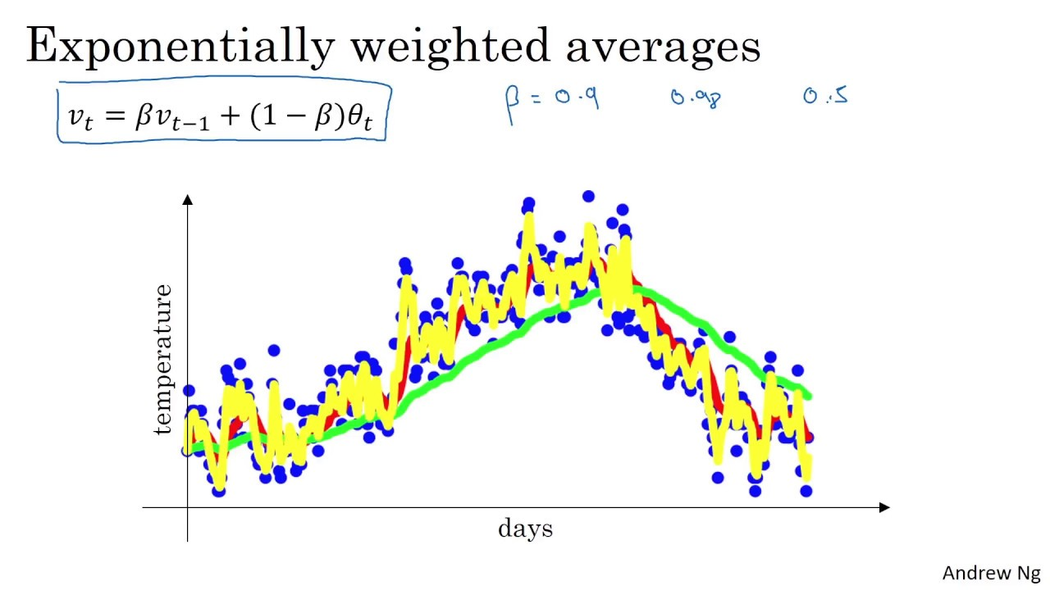

Slide 8
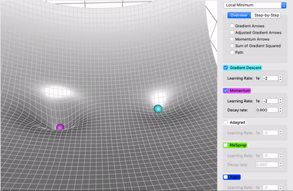
SGD and Momentum

Slide 9
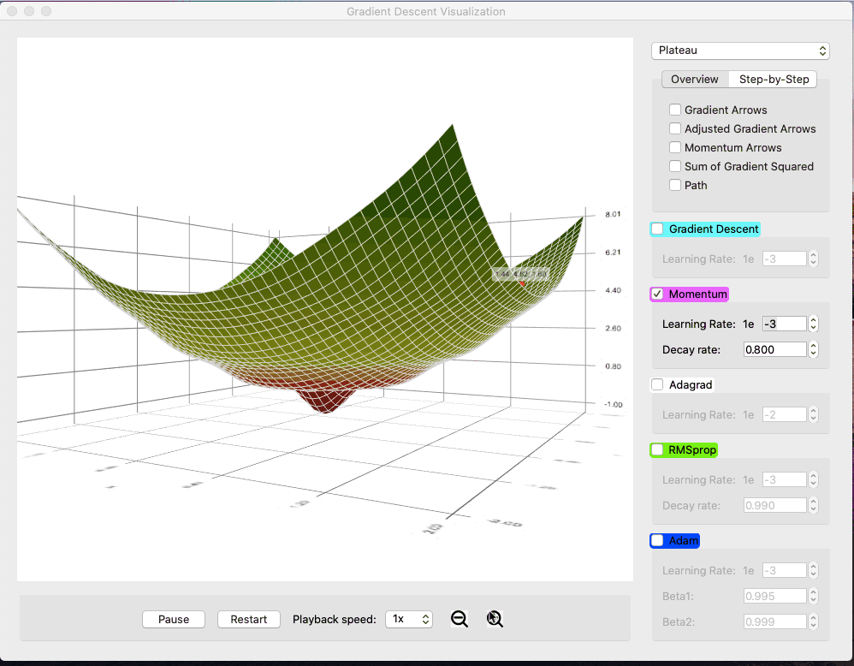
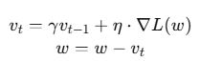
Momentum

Slide 10
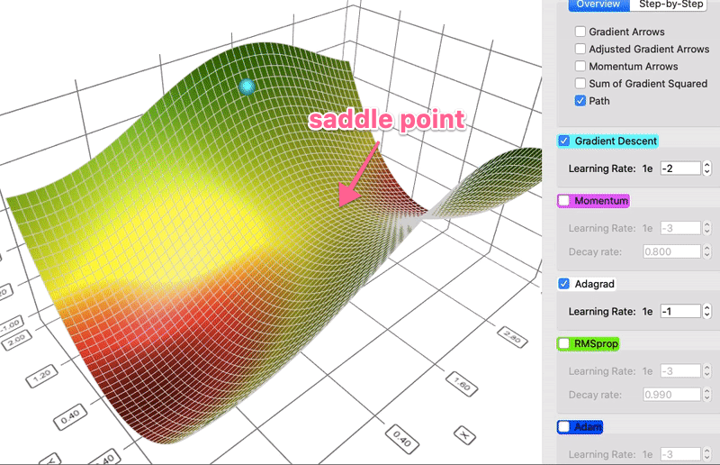
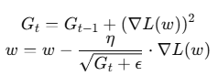
AdaGrad

Slide 11
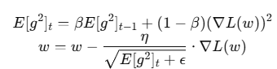
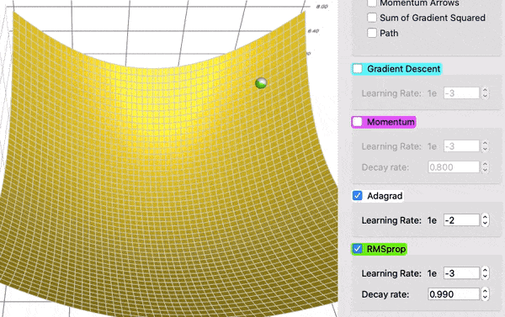
RMSProp

Slide 12
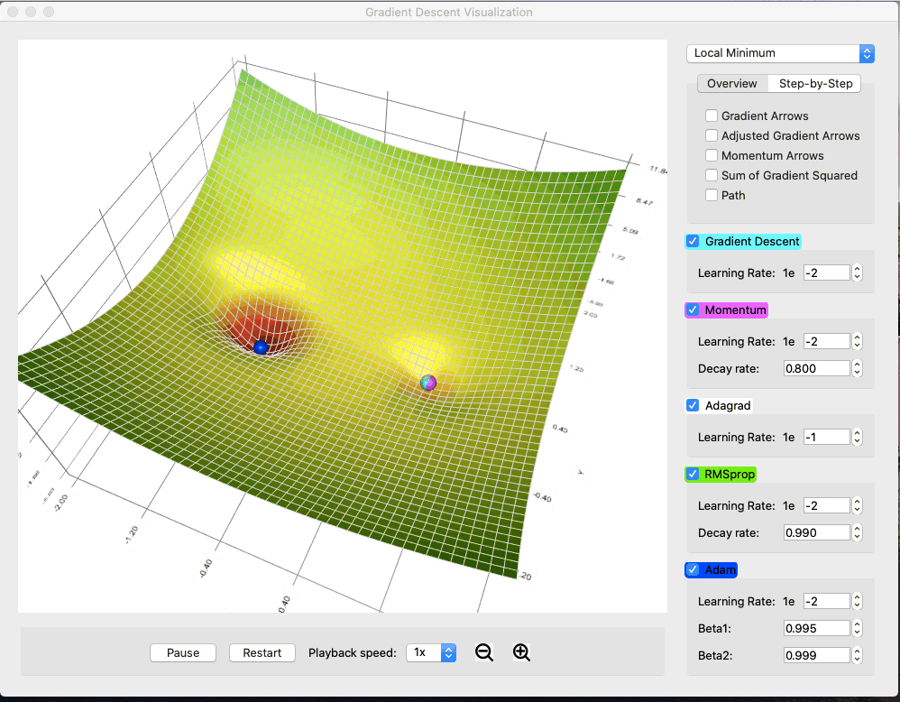
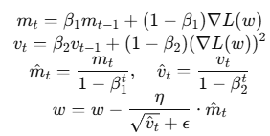
Adam

Slide 13
Optimizers
Optimizer | Key Feature | Pros | Cons
SGD | Basic gradient update | Simple, efficient | Slow convergence
Momentum | Adds velocity | Faster, smoother | Needs tuning
Adagrad | Per-parameter LR | Good for sparse data | LR shrinks too much
RMSProp | Moving average of squares | Stable, good for RNNs | Needs tuning
Adam | Momentum + RMSProp | Adaptive, fast, reliable | Slightly more compute

Slide 14
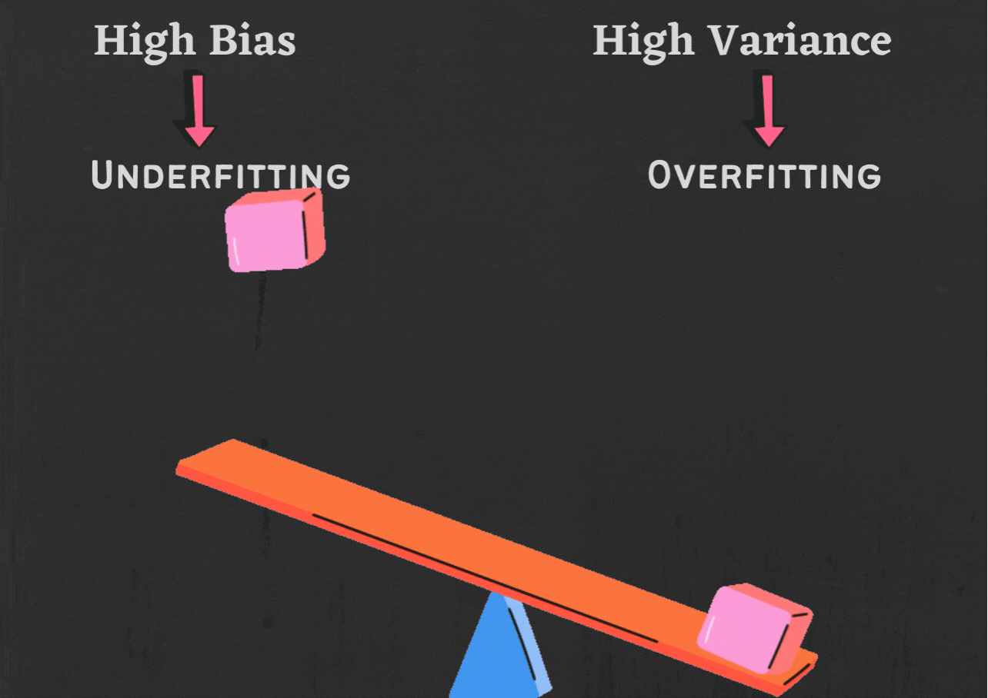
Overfitting vs Underfitting

Slide 15
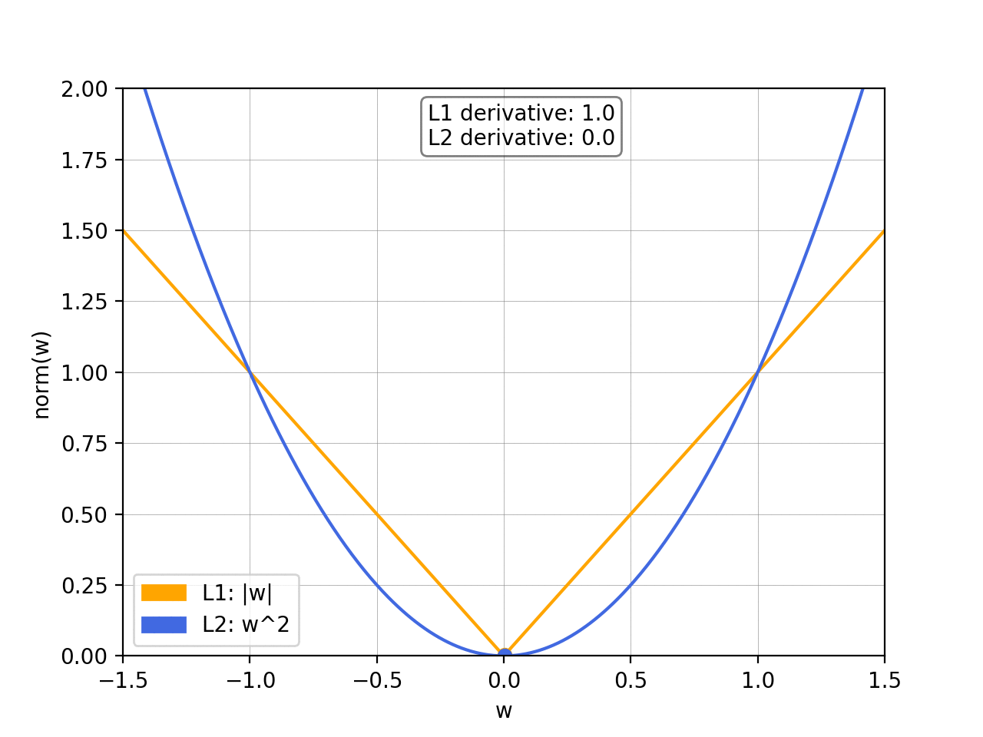
Regularization Techniques

Slide 16
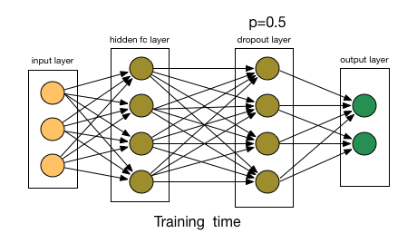
Regularization Techniques

Slide 17
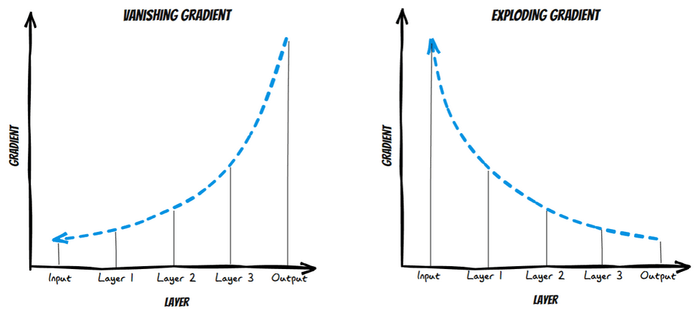
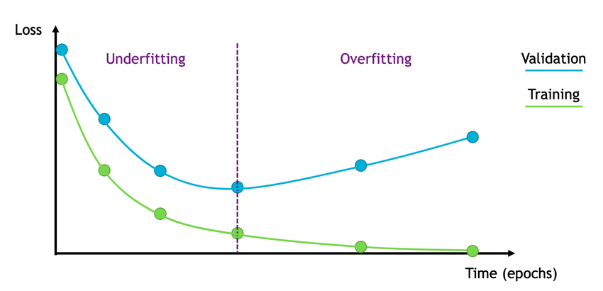
Vanishing and Exploding gradient

Slide 18
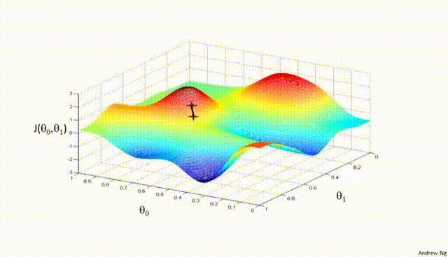
Gradient Clipping

Slide 19
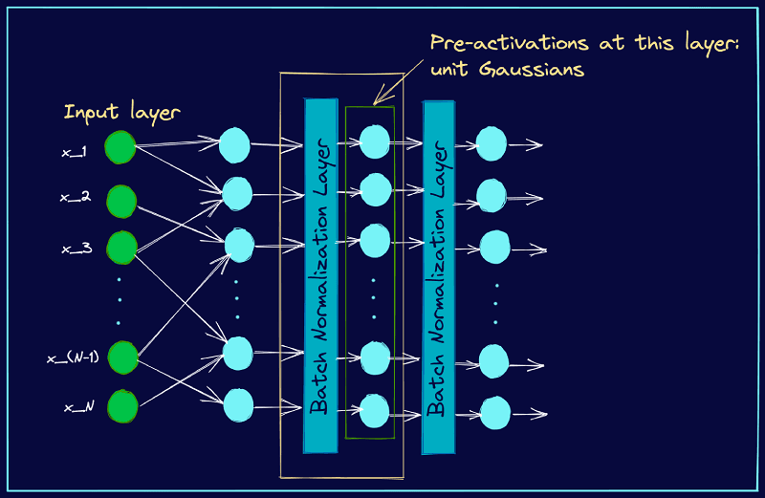
Batch Normalization

Slide 20
Early Stopping

